Slide 1

Capstone Project
Falcon Airlines Passenger satisfaction
Avinash Singh
Great Learning
Objective
Key Data Insights
Data cleaning and variable transformation
Model building and performance
CART model explanation
Recommendation

Slide 2


Passenger Satisfaction
90,917 survey samples
Passenger overall satisfaction
5 key demography parameters
Gender
Passenger Loyalty status
Age
Travel Type (Personal/ Business)
Class (Business, Economy/plus)
13 passenger satisfaction survey parameter
Objective
Identify key parameters which drives passenger satisfaction and provide viable improvement recommendation

Slide 3

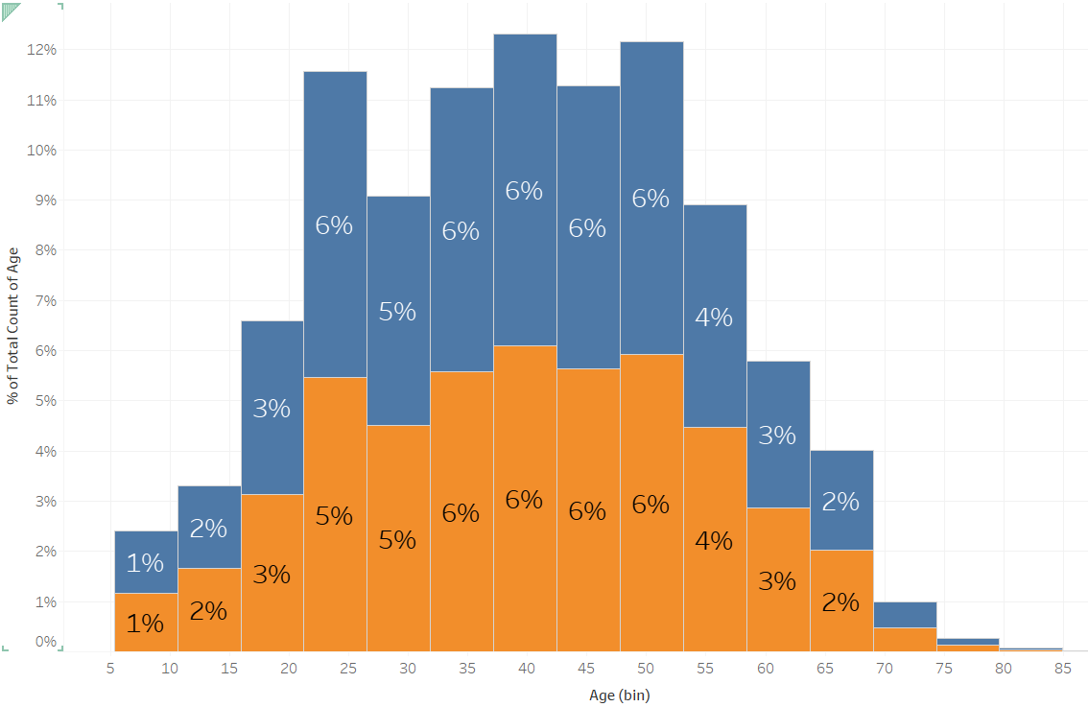
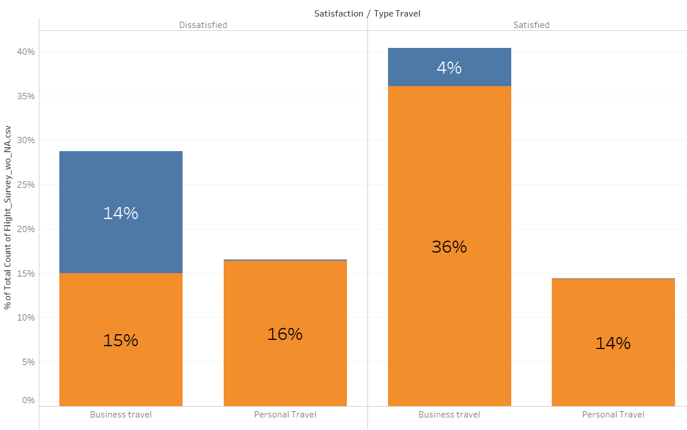
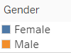
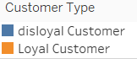
Key data Insights
Passengers surveyed are mostly in the age range of 25 to 55 years old
Mostly equally distributed to males and females
Overall sample demography is balanced
Disloyal customer are rare adopters of personal travels
Disloyal customer possibly choose low-cost airlines for personal travel
Loyal customers are more satisfied

Slide 4
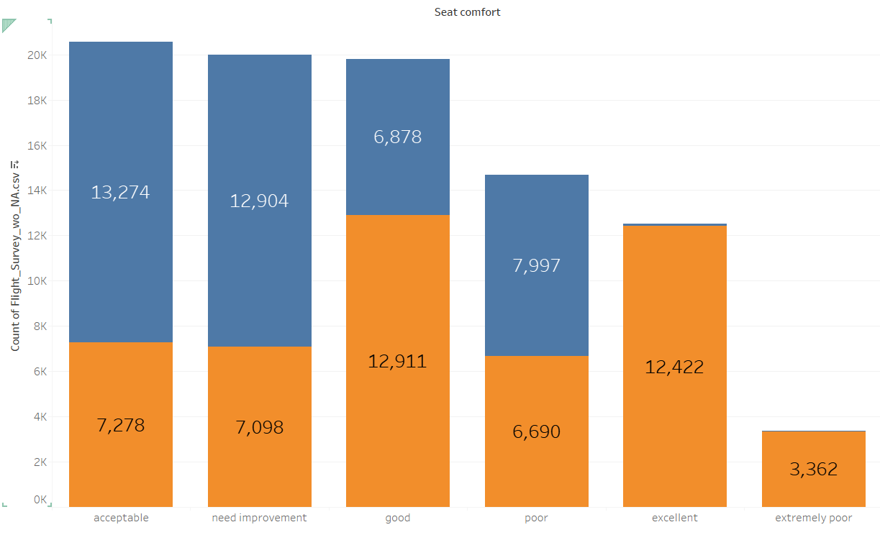
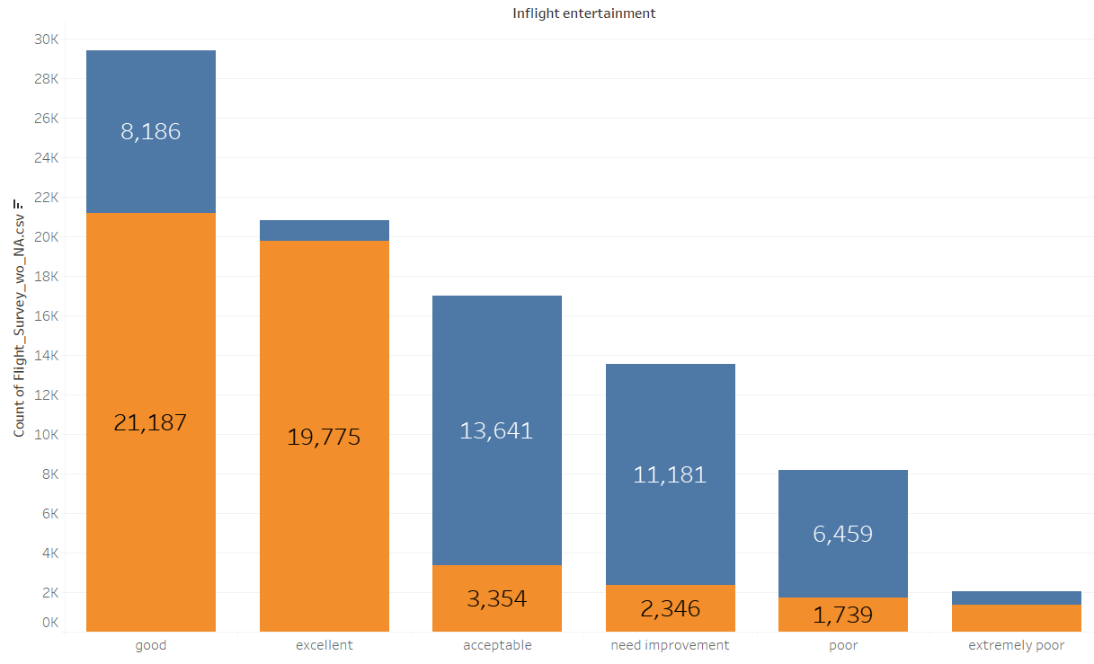
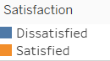
Key data Insights
Mixed response in seat comfort.
Passengers with average experience of seat comfort has overall average satisfaction level
Passengers with excellent seat comfort has overall good satisfaction level.
Seat comfort is one of the key contributors to satisfaction
Clear acknowledgement that below average inflight entertainment will have a direct impact on satisfaction level
A chunk very poor inflight entertainment shows higher satisfied passengers compared to dissatisfied.
A good inflight entertainment leads to approx. 70% overall satisfaction

Slide 5
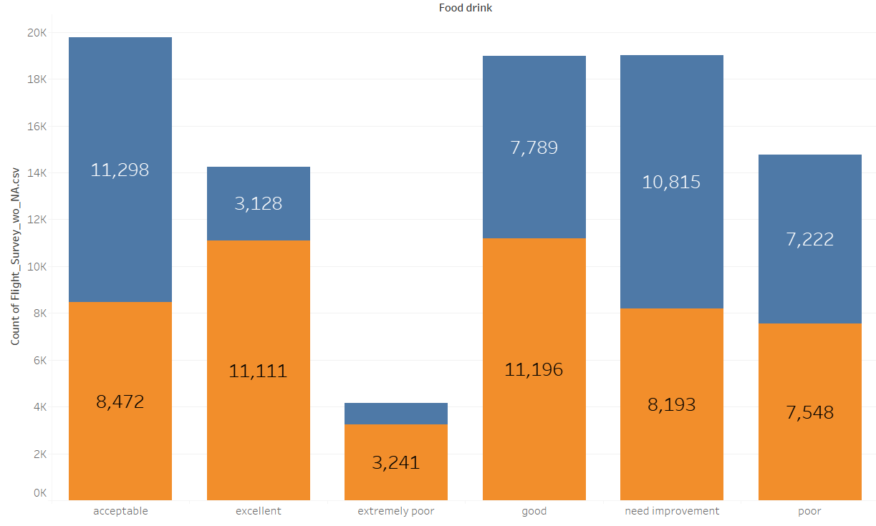
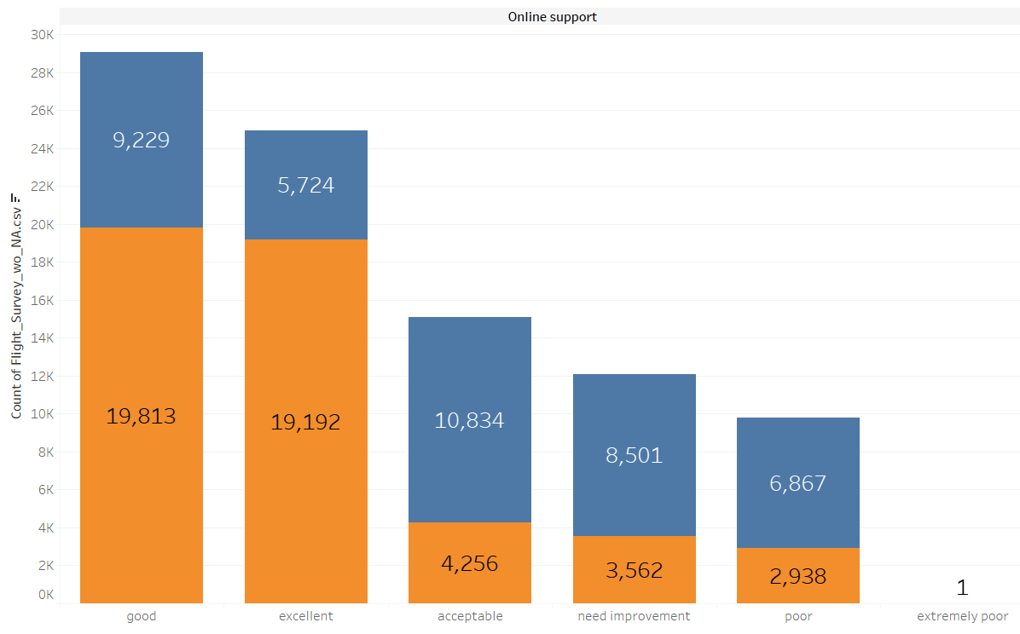
Key data Insights
Food and Drink is not a major driver for satisfaction
Excellent food quality also leads to dissatisfaction for some other metric dissatisfaction
Interesting that extremely poor food quality shows major satisfaction compared dissatisfaction, so it depends on passenger's priority
Below average online support services leads to dissatisfaction
A good online support has a clear direct impact on overall satisfaction level

Slide 6

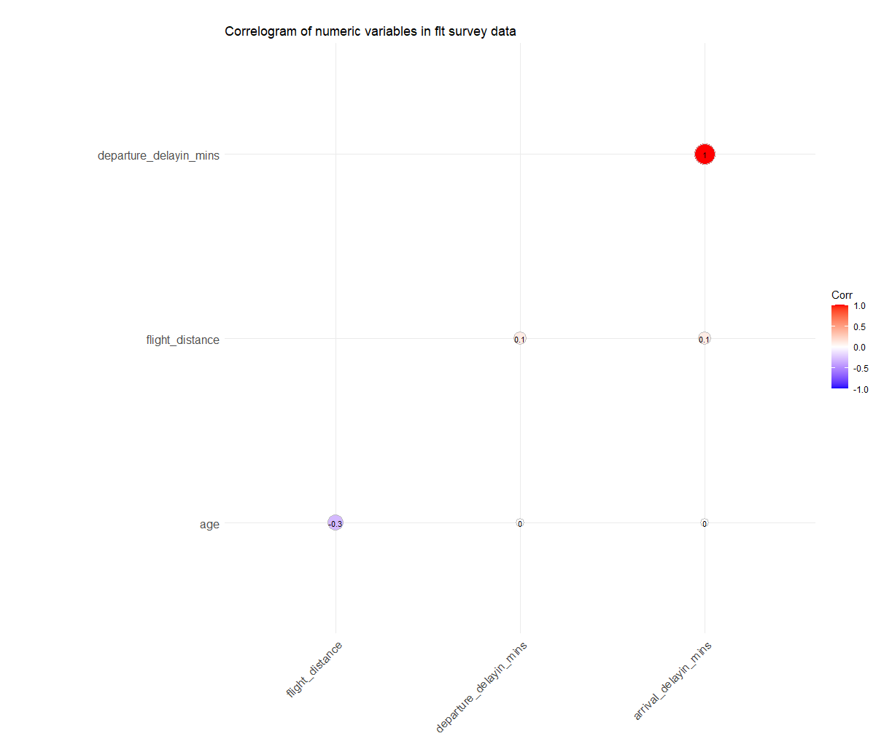
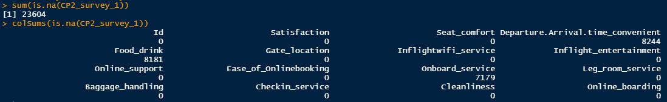
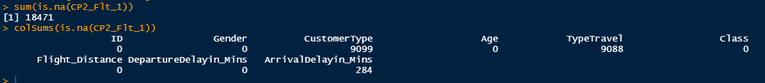
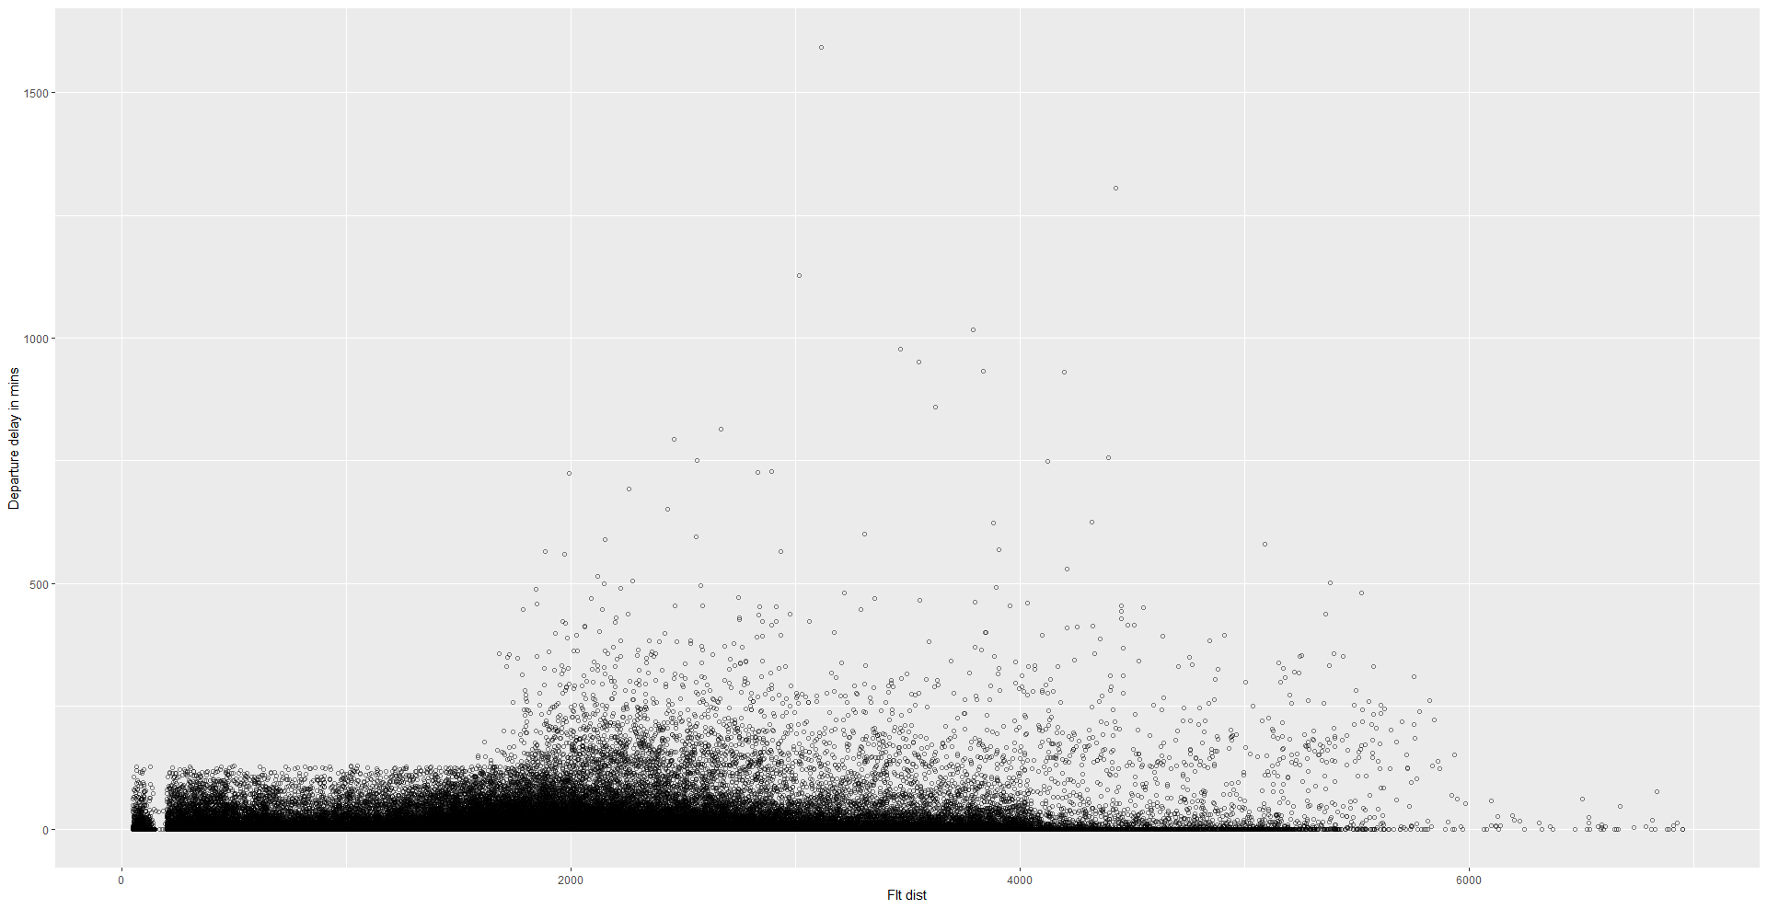
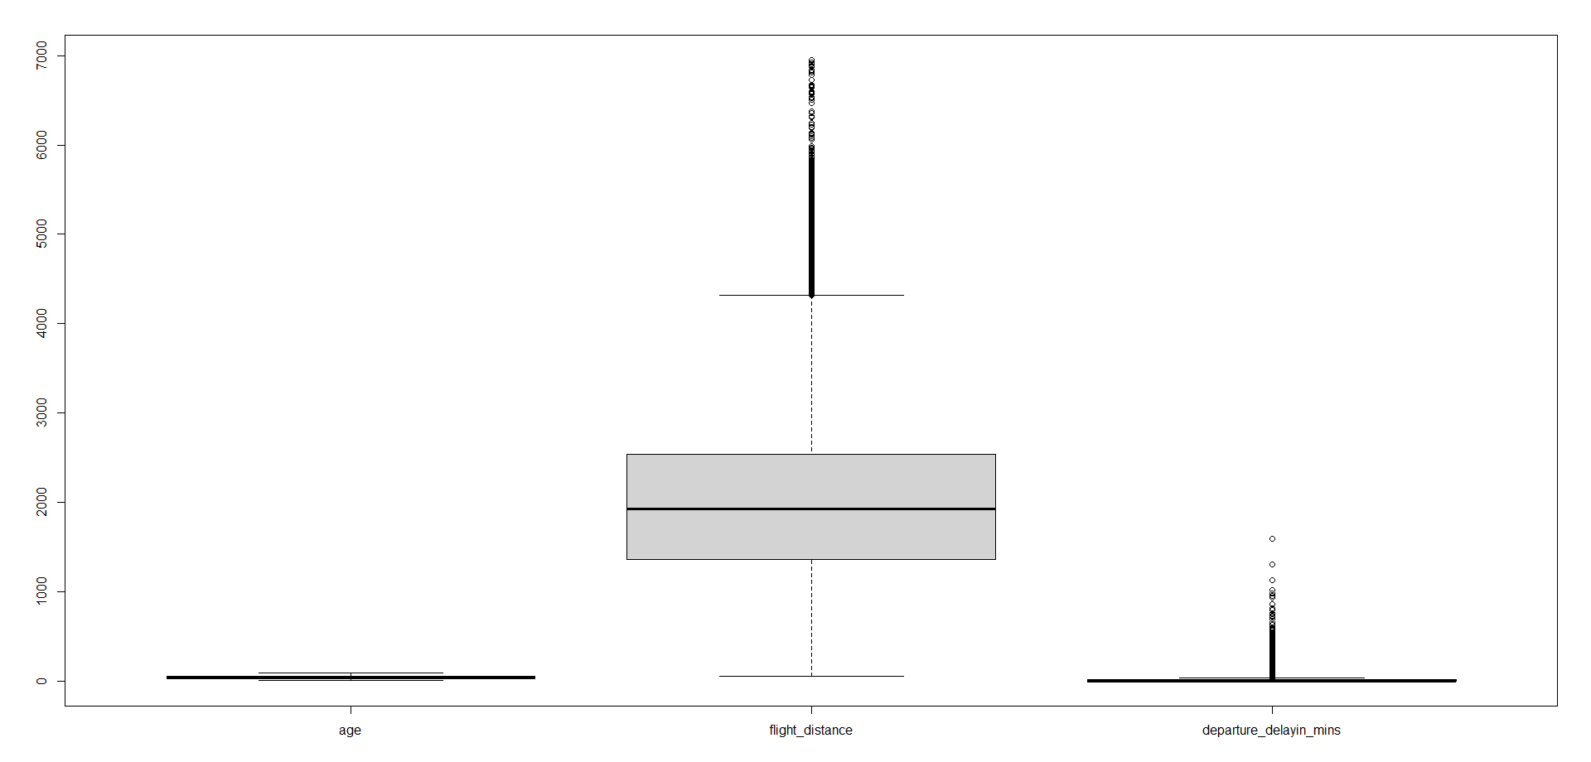
Data cleaning/ Variable Transformation
42,075 missing cells imputed using mice function
Unwanted variables removed (ID and arrival delay in mins)
All survey variable levels transformed to numerical levels
Most of the departure delays are been observed in flights which travel higher distance, more than 2000 miles
While we don’t see many outliers in the age, flight distance has a lot of outlier due to the nature of variable as the airlines is a global airline and would have short and long distance flights.
Also, there are likely chances that while most of the flight has 15 mins of average delay, there are outliers in the delay of upto 1300+ mins

Slide 7
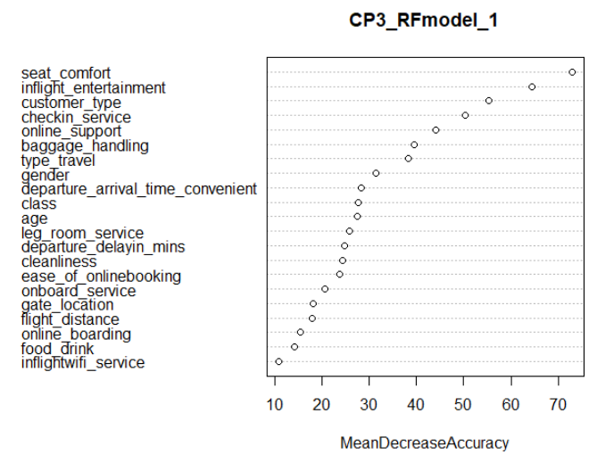
Model building and performance
Logistic regression:
The model was used to predict the satisfaction level of passengers with respect to the independent variables.
Identify the impact on satisfaction for every unit changes in the independent variables
CART Model:
Used for solving both regression and classification problems
A decision tree consists of a root node which splits into decision nodes/branches, depending on the outcome of the branches the next branch or the terminal /leaf nodes are formed.
This model was used in the project to identify the top factors and the parameter per factor impacting Passengers satisfaction.
Random Forest:
Random forest algorithm can also be used for both classifications and regression task.
It provides higher accuracy through cross validation
This model is used for prediction purpose as it has delivered highest accuracy and performed better than other models
Other models used for prediction purpose as shown below but overall accuracy is low compared to Random forest.
Naïve bayes
KNN Model
Gradient Boosting
Extreme gradient boosting

Slide 8
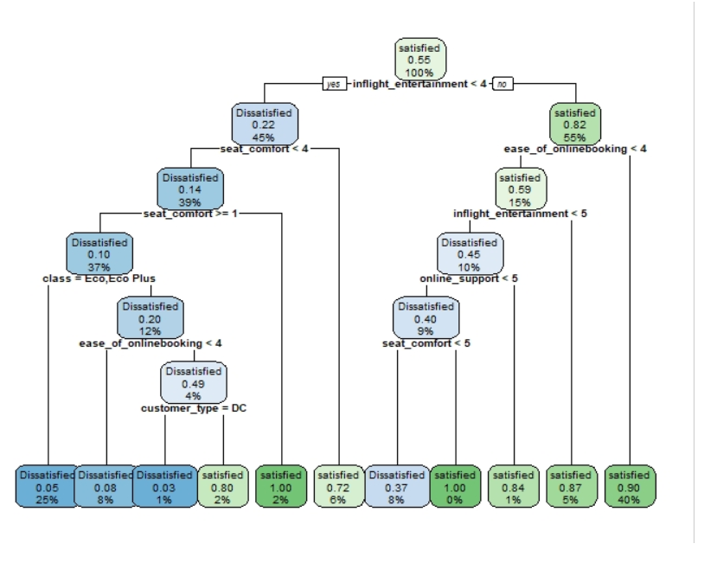
CART decision tree
Based on the cart decision tree, it is recommended to identify key areas of improvement in Inflight entertainment
It is observed that 40% of the passengers are satisfied with an excellent inflight entertainment experience and ease of online booking.
25% of passengers are dissatisfied if there are 10% probability of them being an eco or eco plus class passengers with a seat comfort of less than good or more than poor.
6% of passengers are satisfied even if their inflight experience is low (good or below) but they have an excellent seat comfort.

Slide 9
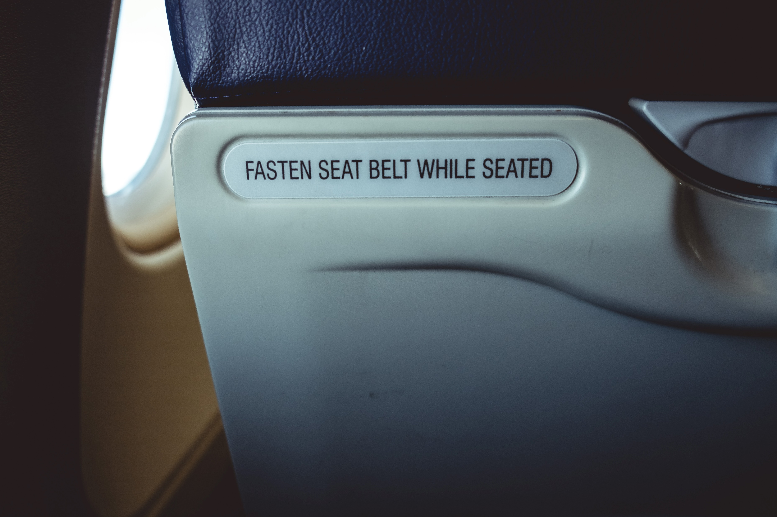

Recommendation
Collaborate with leading OTT players to offer trending contents inflight
Allow customer to pre book contents while booking tickets
Attract disloyal customer and convert them to loyal one’s, offering free content access upon signing up for loyalty.
Loyal customers are more satisfied and enjoying loyalty benefits
Offer complementary comfortable seats for frequent flyers by learning on the number of journeys or last-minute upgrades .economy to business class.
Height adjustable seats
Baby seat box.

Slide 10

Thankyou

Slide 11
Back up slide

Slide 12
Tentaive BoQ/ Revenue/ profit for deploying OTT server per flight
SN | Product description | Qty | Weight | power watt (AC/DC) | OTT | Cost
1 | Rack server | 2 | 30 kg | 1100 | Netflix | € 12,000
2 | Swicth | 1 | 4 kg | 100 | Netflix | € 3,000
3 | Router | 1 | 2 kg | 100 | Netflix | € 3,000
Total |  |  | 36 kg | 1300 |  | € 18,000
For 3 OTTs |  |  | 108 kg | 1500 |  | € 24,000
Average flight tickets per person |  |  |  |  |  | € 200
Average passenger per flights |  | 39
Total |  |  |  |  |  | € 7,800
% satisfied customers due to inflight entertainment |  | 55%
Assumed percentage of new satisfied customers |  | 20%
Total new satisfied customers per flight |  | 8
Enhanced revenue |  |  |  |  |  | € 1,538
Total value to Falcon airlines (profit @ 10%) per flight |  |  |  |  |  | € 153.80
Total annual fly (assuming 1 fly per day) |  | 365
Total value per flight |  |  |  |  |  | € 56,137
Actual saving after investment |  |  |  |  |  | € 32,137
Total content per OTT |  | 150
Average charges per event per OTT platform |  |  |  |  |  | € 50
Total charges to OTT |  |  |  |  |  | € 22500
Final annual savings per flight |  |  |  |  |  | € 9,637
Cost and benefit analysis

